Slide 1

Identification of Novel Antiviral Compounds against Coronavirus Exonuclease NSP14
Mackenzie L. Anderson, Ph.D.
Heaton Laboratory
Duke University School of Medicine

Slide 2
Identification of Novel NSP14 Inhibitors with TimTec AG50K Library
141 Compounds w/ 66% or less activity compared to DMSO
Average Screen Z-Factor = 0.93
Notes:
INCLUDE PERCENTAGE OF HITS WITHIN BOX VS THOSE THAT ARE COMPARABLE TO WT/DMSO

Slide 3
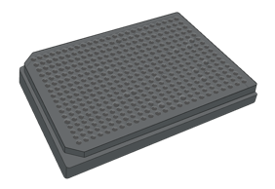
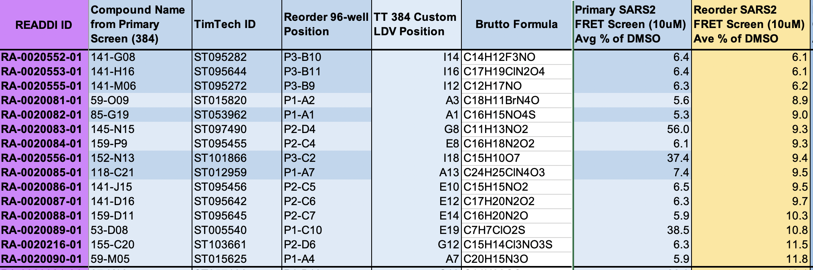
Selection of Top 15 NSP14 Compounds
Reordered compounds - custom 96-well plates w/ top 141 hits
(<66% activity)
Incubation w/ NSP14 for 2.5 hrs at RT; Probe added w/ 30 min reaction time; Plate read
Measured % RNA Cleavage normalized to DMSO

Slide 4
12-Point IC50 Curves
159-P9
RA-0020084-01
141-D16
RA-0020087-01
Top 15 Compounds based on revalidation screen
141-H16
RA-0020553-01
159-D11
RA-0020088-01
Measured % RNA Cleavage normalized to DMSO
2-Fold changes from 20 µM to 0.0097 uM
141-M6
RA-0020555-01
141-G8
RA-0020552-01
141-J15
RA-0020086-01

Slide 5
12-Point IC50 Curves
53-D8
RA-0020089-01
118-C21
RA-0020085-01
Top 15 Compounds based on revalidation screen
59-M5
RA-0020090-01
145-N15
RA-0020083-01
Measured % RNA Cleavage normalized to DMSO
2-Fold changes from 20 µM to 0.0097 uM
59-O9
RA-0020081-01
152-N13
RA-0020556-01
85-G19
RA-0020082-01
155-C20
RA-0020216-01

Slide 6
Compounds sent to Peter & Ken (UNC) and Sara (UPenn)
Peter & Ken – Top 15 FRET Compounds
Top 15 FRET compounds selected based on revalidation screen with custom TimTec 96 well
QC on compounds and other analyses
Sara – Potentiation of Nucleosides & Synergy Studies
6 compounds sent based on remdesivir potentiation in Heaton Lab
159-P9, 141-D16, 141-M6, 152-N13, 159-D11, 141-J15
Perform HTS/dose response compounds
Synergy studies with SARS-CoV-2 and various coronaviruses (MERS, 229E, etc.)
Test compounds against nucleoside library

Slide 7
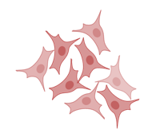
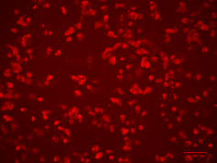
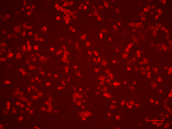
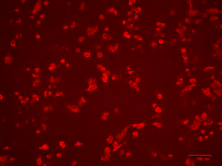
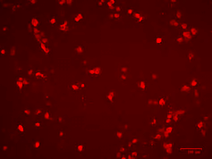
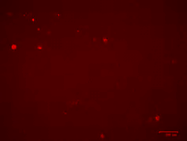

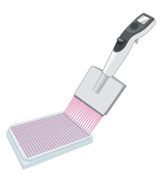
Potentiation of Remdesivir with SARS-CoV-2 NSP14 Compounds
0.1 uM
0.3 uM
1 uM
3 uM
9 uM
27 uM
Day 1:
Plate A549 ACE2 cells in 96 well plates
Day 2: SARS-CoV-2
Infection with SARS-CoV-2 for 1 hr 37°C
Addition of 30 uM Compound + varying concentrations of Remdesivir in 2% DMEM; Incubate 48 hrs
Day 4:
Fix and stain for microscopy analysis
SARS-CoV-2 Spike Protein

Slide 8
Ongoing & Future Experiments:
Future Experiments:
Ready to test analogues or derivatives
Optimizing specific infectivity experiments after serial growth in compounds
Potentiation of chain-terminator nucleoside analogues

